Slide 1
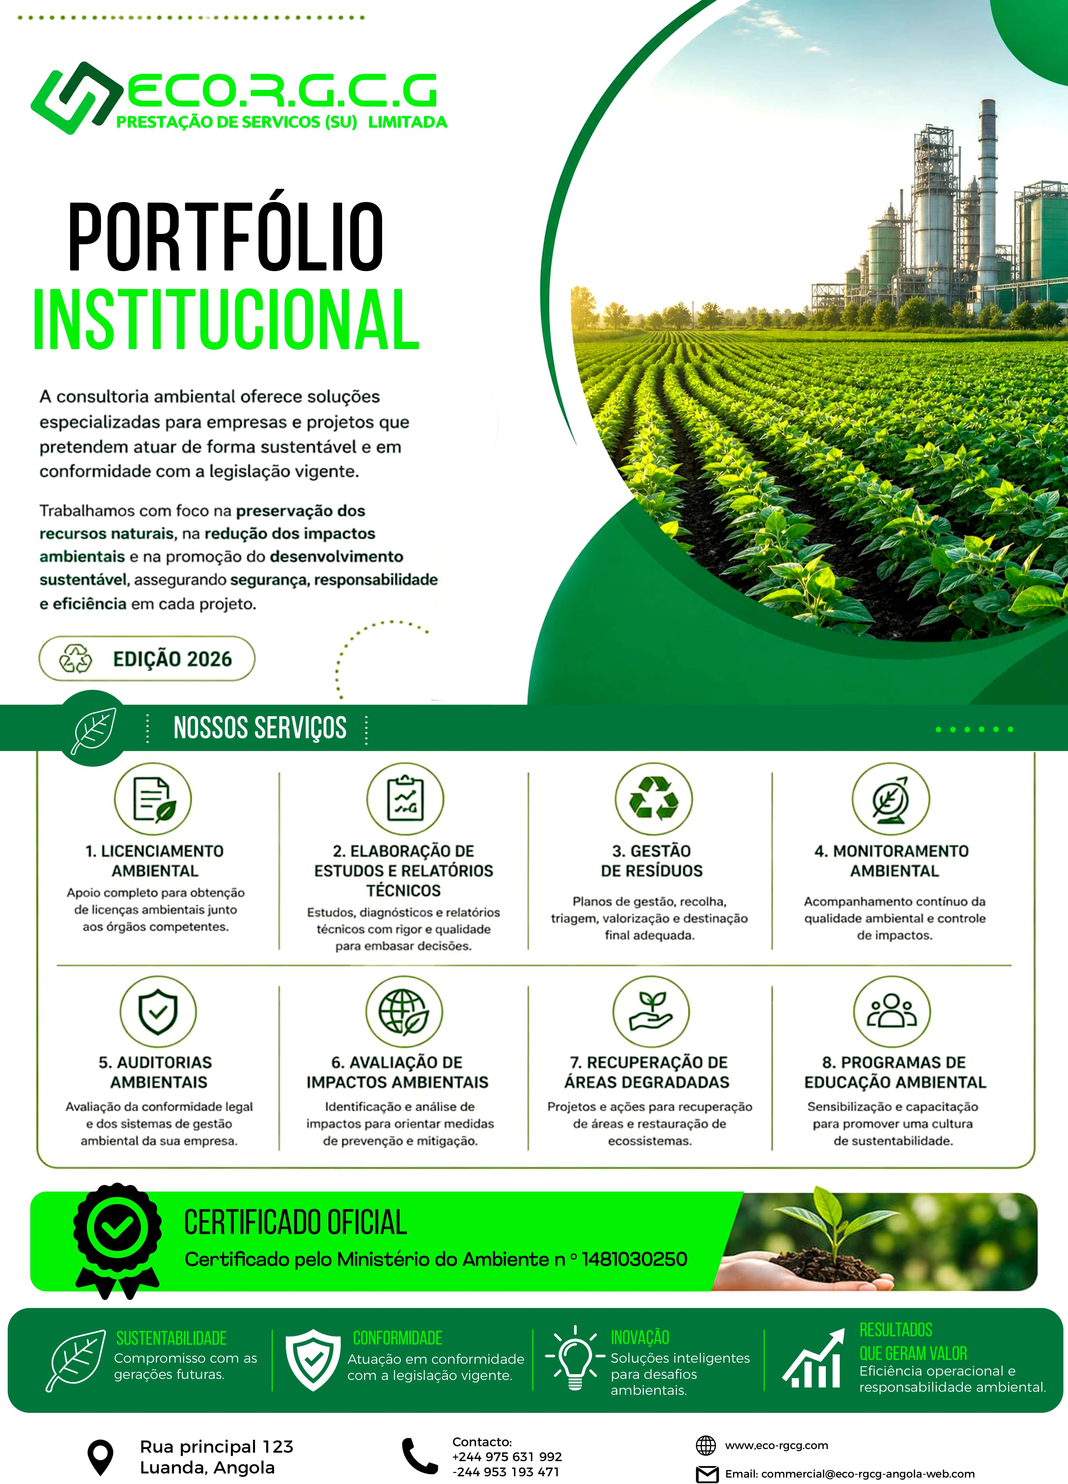

Slide 2
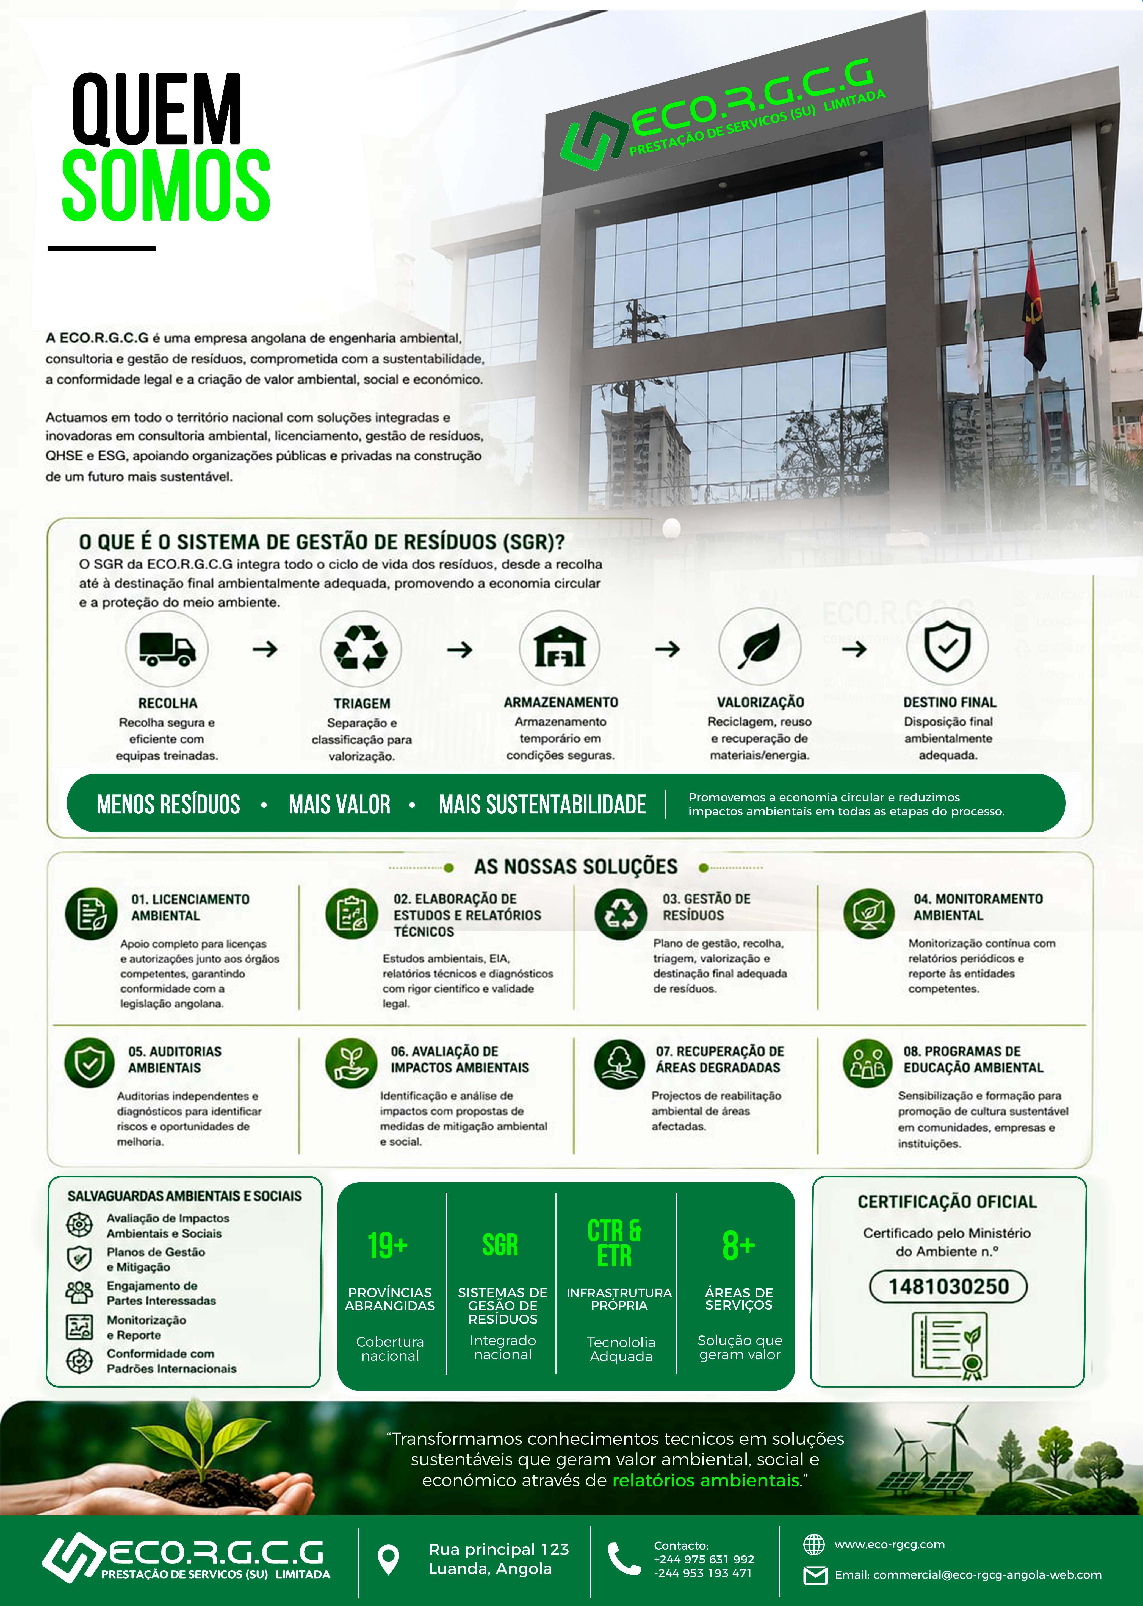

Slide 3


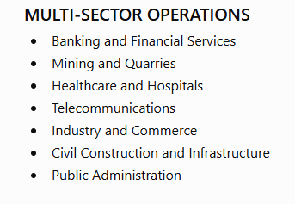
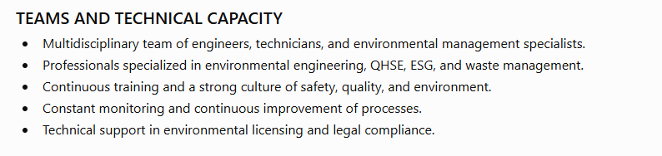
fCO.t.G.C.G
Where We Are, How We Operate
PRESTAÇÄO DE SERVICOS (SU) LIMITADA
An integrated operational structure that ensures efficiency, traceability, and environmental compliance across multiple sectors of activity.
NATIONAL COVERAGE
Operational presence throughout the country, supported by local teams and strategic partners, ensuring proximity, agility, and legal compliance.
OPERATIONAL STRUCTURE
Two complementary business units that ensure integrated, efficient, and fully traceable waste management operations
SGR’s main unit focuses on the valorization and proper management of waste
0
03 /
PROVINCE
Technical sorting and classification
Valorization of recyclable materials
Safe and temporary storage
Forwarding to licensed operators
Traceability and flow control
02
NATIONAL
 | OJ | Luanda | 1J | Bengueb
07 | 02 | Bcngo | 12 | Huam&
 | 03 | Uige | 13 | Bié
 | 04 | Cabinda | 14 | Moxico
 | 05 | Zaire | JS | Cuando
 | 06 | Cuanza Norte |  | Cubango
 | 07 | Malanje | J7 | Huila
 | 08 | Lunda horte | 18 | Namibe
18 | 09 | Lunda Sul | J9 | Cunene
 | IO | Cuanza Sul
10
J2
Provincial support and coordination units that ensure logistical and operational support for SGR.
ETR –
Waste Sorting Station
Reception of waste
Segregation and proper packaging
Safe temporary storage
Logistical support for operations
Provincial coordination and coverage
Local teams
Conłw<•+n<nto tciri:orul
*••£ .F•*
Strategic Partnerships
RI+dr dc j>arcrirorc. op<•rado'r=
Compliance
Atuaç6o alinhada .›
Integration & Standardization
An integrated CTR and ETR network that ensures coverage, process standardization, and operational efficiency across all regions of the country.
Our SGR Operational Model – Focus on Control and Transparency
PLANNING AND ADHESION
Diagnosis, waste assessment, and definition of the operational plan.
CONTROLLED EXECUTION
Execution of operations using standardized procedures and trained teams.
TRACEABILITY AND COMPLIANCE
Recording and issuing manifests, documents, and evidence for each stage of the waste lifecycle.
MONITORING AND REPORTING
Tracking operational, environmental, and ESG indicators through periodic reports and dashboards
CONTINOUS IMPROVEMENT
Internal audits, performance evaluation, and corrective actions to improve processes.
PROVEN IMPACT
Generation of environmental, social, and economic value with legal compliance and responsibility.
Ț@/ Bcnca e Serviços Finsnceiros
EOUIPAS E CAPACIDAOETÉCNICA
Equip‹a multidisciplinar com engenheiros,
tčcnïcos e cspeci‹»Iíst‹as em gcstao ‹ambient‹nl.
łdineraçšoc Pedreiras
Profissionais e»pecializados em engenharia
»mbientnl. QHSE, ESG e gestño de residuos
Saúde e Hospitalar
Form.aç‹śo continua e cultura de segurança. qualidade e ambiente.
Tclecomunicaçóes
@
Indústria e Comźrcio
Monitoriz.açśo constante e melhoria contínu.a dos proccssos.
'
Construçăo Civil e Infraestruturas
Apoio tč•cnico cm Iiccnci•^monto .ambiontal
e conformidade legal.
ȚȘ@ Administr‹cçšo Pública
SOLUÇÖES INTEGRADAS PARA
*° UM FUTURO MAIS SUSTENTĂVEL.
Compromisso com
e conformidade legal, a qualidade e a
respons.abilidade ambiont.aI.
Promovemos a economia
impactos ambientaïs em todas as etapas.

Slide 4
